Slide 1
SmartHouse
QOL - Quality Of Life

Slide 2
Outline
Intro
System Overview
OCD
SSS
Data Flow and State Diagrams
STD
Conclusion

Slide 3
Intro - Old System
No voice commands
  No way to have your house immediately apply to your needs
No personal profile
  No way to store personal preferences or privileges to comfort your every day life
No personal schedule
  No way to have your house guide you through the day

Slide 4
SmartHouse
Transition from the overall system to where our component fits into it
DFD-C
DFD-3.4

Slide 5
DFD-3.4.5
Introducing QOL components
QOL DFD-0

Slide 6
OCD-Voice
New features

Slide 7
OCD-Schedule
There will be a main database for the schedule for everyone in the house
This data base will provide information to components
  Light Controllers
    Gets schedule and current time
  HVAC Controller
    Gets schedule and current time

Slide 8
OCD-Profile
New features

Slide 9
SSS-Voice
Major requirement

Slide 10
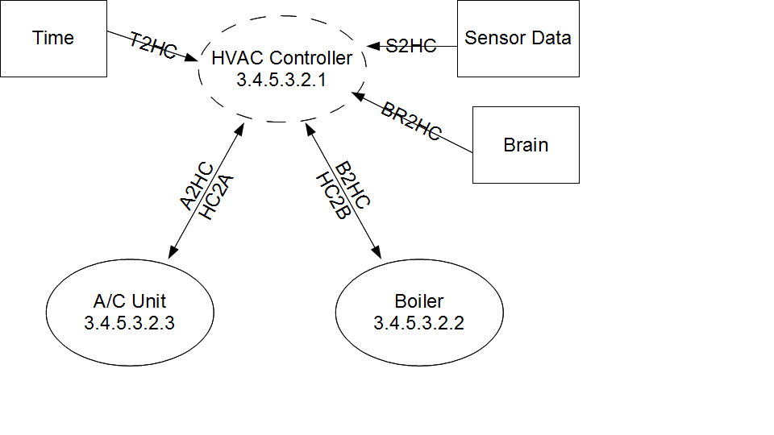
SSS-Schedule
Major Requirements
  HVAC Controllers

Slide 11
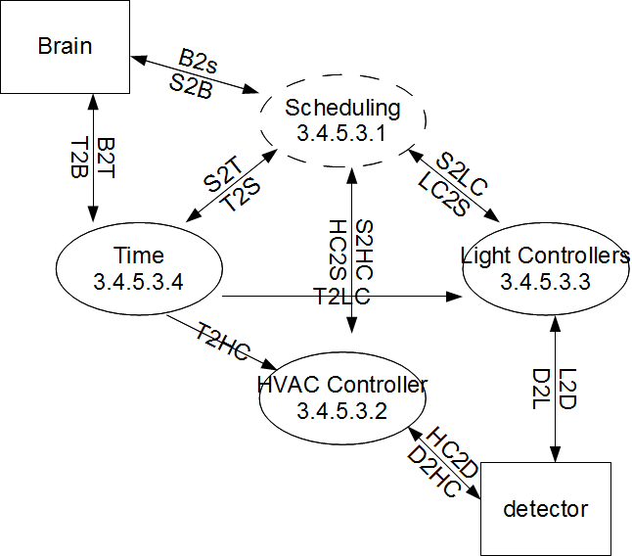
SSS-Scheduling

Slide 12
SSS-Profile
Major requirement

Slide 13
Diagrams-Voice
DFD
STD

Slide 14
Diagrams-Schedule
DFD
STD

Slide 15
Diagrams Profile
DFD
STD

Slide 16
STD-Voice
Test description

Slide 17
STD-Schedule
Test description

Slide 18
STD-Profile
Test description

Slide 19
Conclusion
Key feature voice commands
  ...
Key feature personal profile
  ...
Key feature personal schedule
  Will control all the lights,time, and HVAC schedules

